Slide 1
Ancient Mediterranean Worlds
Africa, the near East and Europe
where Western Art begins……

Slide 2
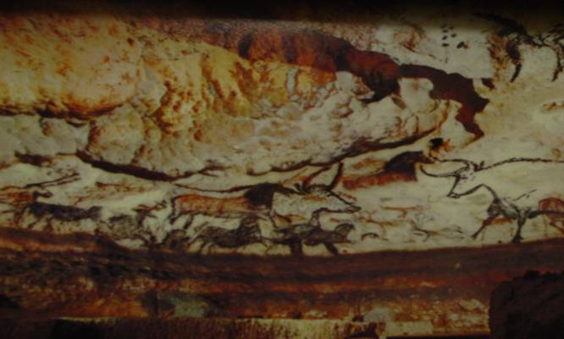
The Oldest Art
Wall paintings of the Chauvet cave in France dated 30,000 B.C.E

Slide 3
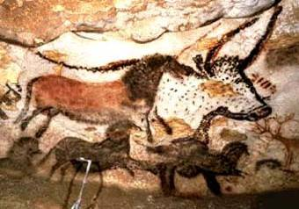
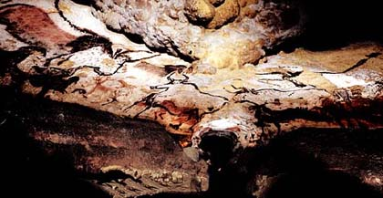
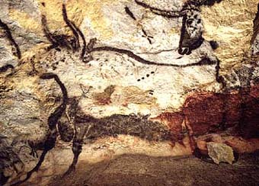
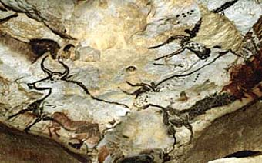
Lascaux Cave 15,000 B.C.E

Slide 4
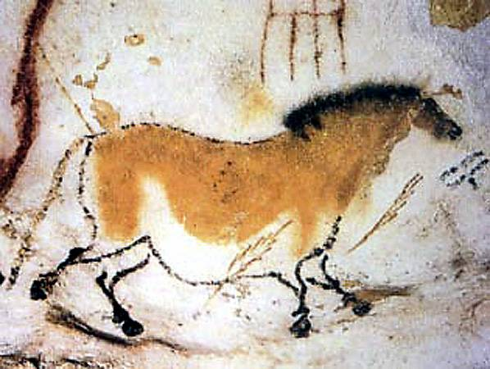
Lascaux Cave Chinese Horse

Slide 5
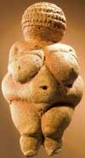
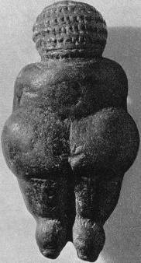
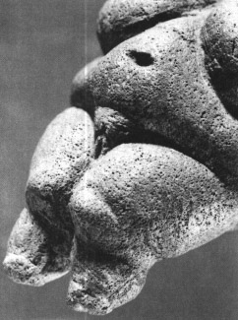
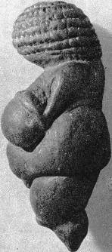
Venus of Willendorf c. 23,000 B.C.E. Limestone 4 3/8” Austria

Slide 6
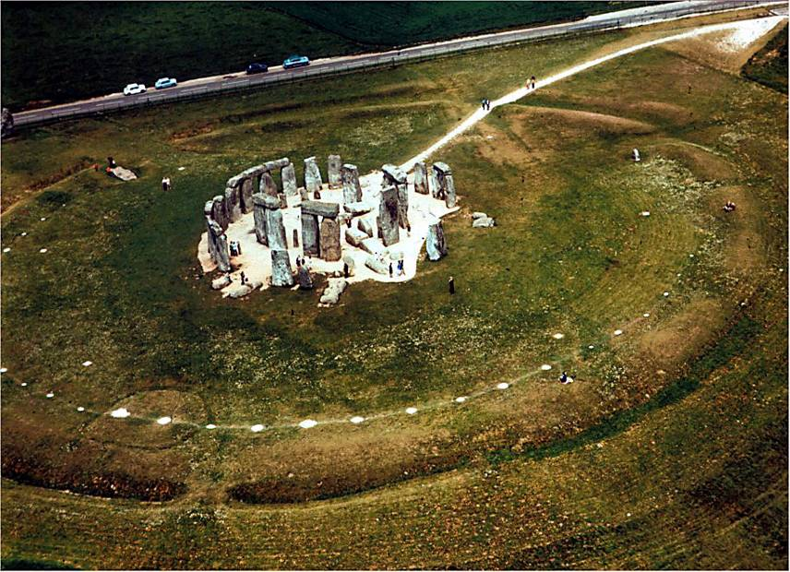
Neolithic Stonehenge

Slide 7
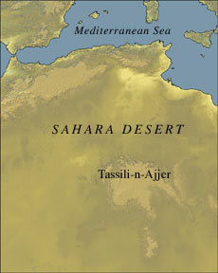
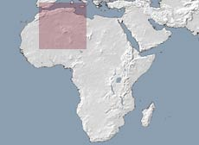
Ex. Of Neolithic daily life

Slide 8
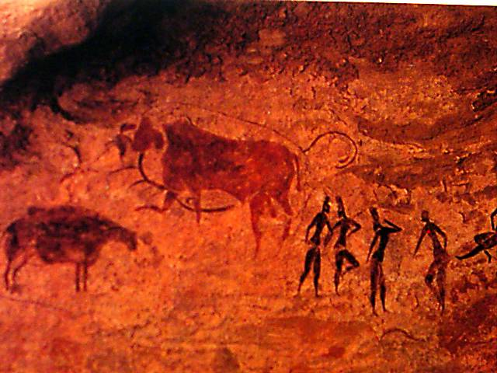
Women and Cattle. Rock painting at Tassili n’ Aijer, Algeria. Pastoralist style, after 5000 B.C.E

Slide 9
Conditions that promote the preservation of artworks for thousands of years
The artists worked in durable materials such as stone, metal, and fired clay.
Local environment is not destructive to artworks.
the culture was highly organized, stable population center.
The culture had a tradition of caching its artworks limited or no accessibility.

Slide 10
Mesopotamia

Slide 11
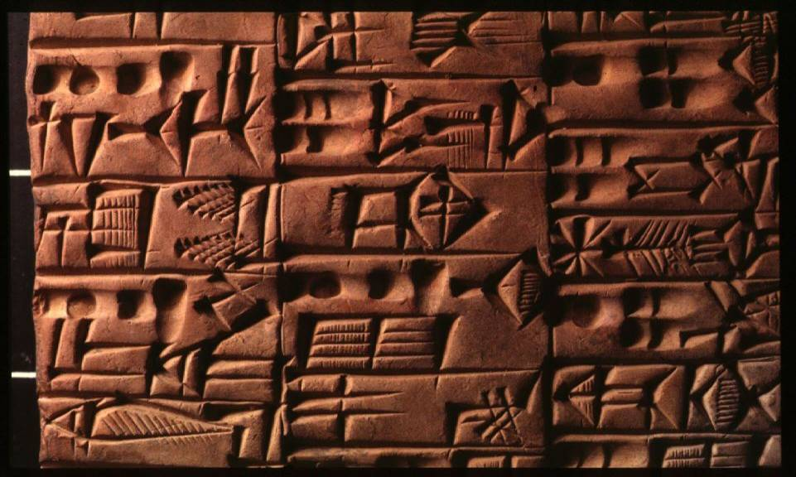
Mesopotamian-Sumerian Cuneiform (Latin for “wedged shaped”) Sumerian

Slide 12
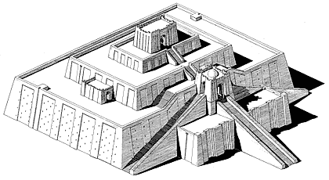
Ziggurat

Slide 13
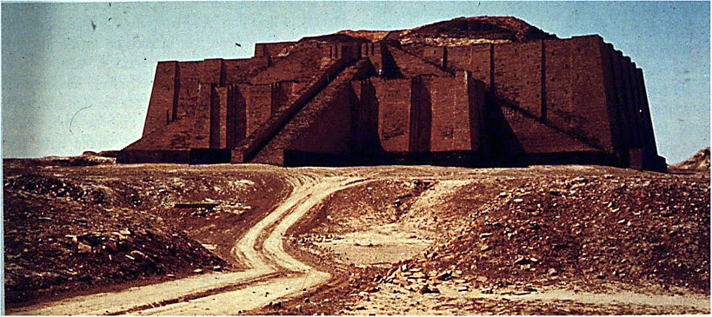
Nanna Ziggurat

Slide 14
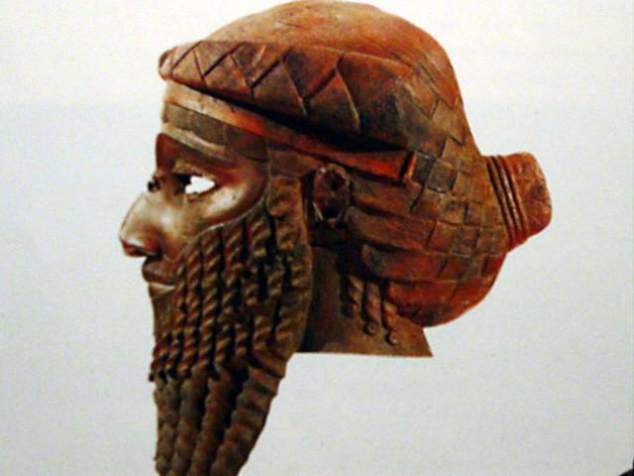
Mesopotamian-Akkadian Head of an Akkadian ruler (Sargon 1?)

Slide 15
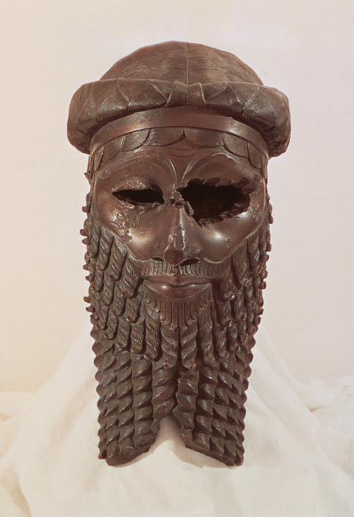
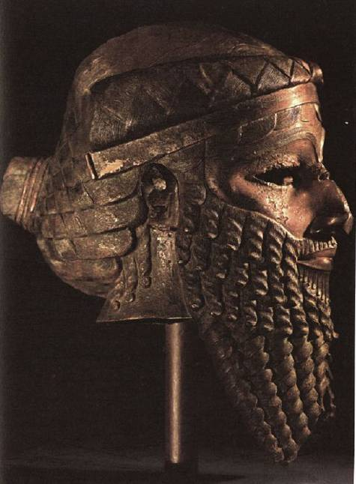

Slide 16
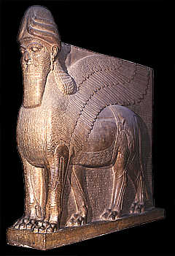
Mesopotamian-Assyrian Colossal statue of a winged human-headed bull from the NorthWest Palace of Ashurnasirpal II Protecting the palace against demonic forces

Slide 17
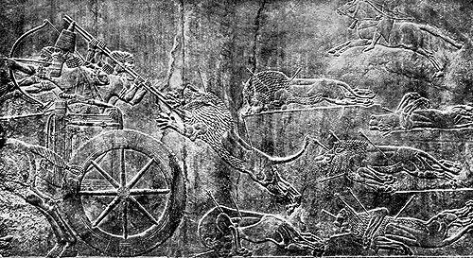
Lion Hunt, from the palace complex of Assurnasirpal II

Slide 18
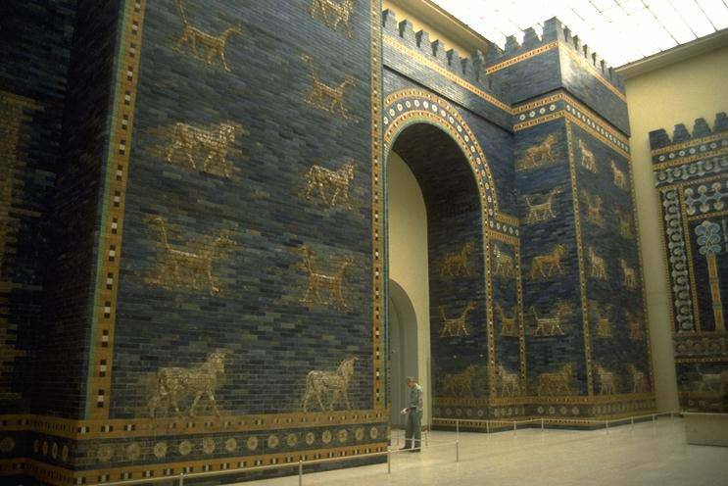
King Nebuchadrezzar II Ishtar Gates, built about 575 B.C.E. , 47 feet high and 32 feet wide

Slide 19
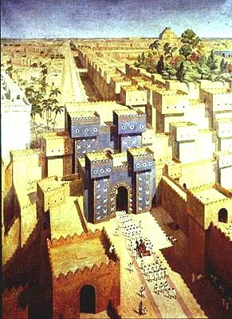
The Ishtar Gate was the eighth gate to the inner city of Babylon

Slide 20
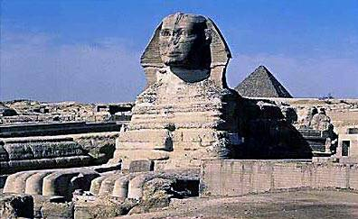
Egypt The Sphinx is the essence of Egyptian art, continuity, stability, order, and endurance.2530 B.C.E.

Slide 21
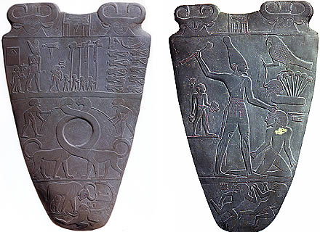
Egyptian-PreDynastic Palette of Narmer, c. 3100 B.C.E

Slide 22
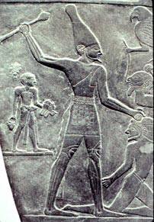
Typical Egyptian Pose
Lower Body in profile
Torso full front
Head in profile
Eye frontal

Slide 23
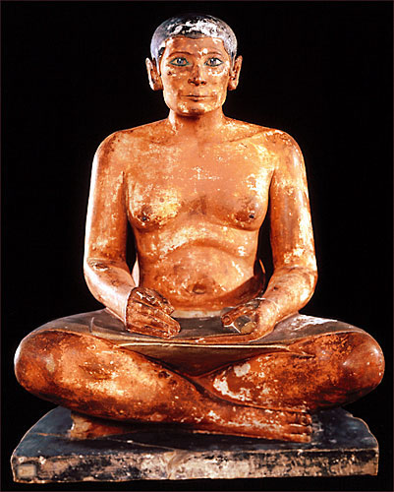
Seated Scribe, c. 2450 B.C.E. painted limestone

Slide 24
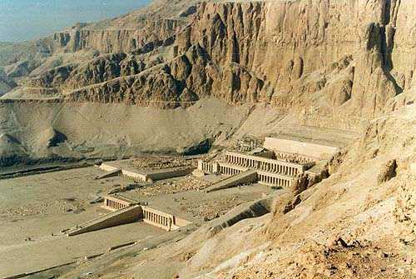
Funeral temple of Hatsheput, Deir el-Bahric. 2009-1997B.C.E. EIGHTEENTH DYNASTY

Slide 25
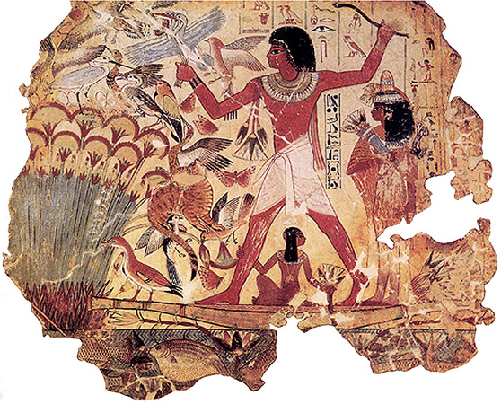
Fragment of a wall painting from the tomb of Nebamun, Thebes. C. 1450 B.C.E.

Slide 26
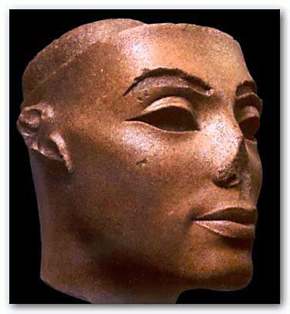
The Amarna Period Queen Nefertiti 1345 B.C.E.

Slide 27
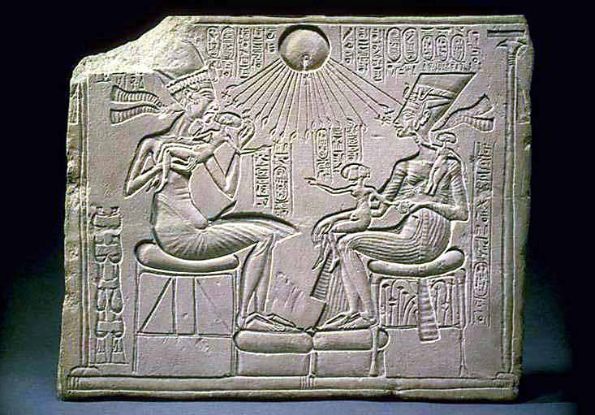
Akhenaten and His family. C. 1345 B.C.E.

Slide 28
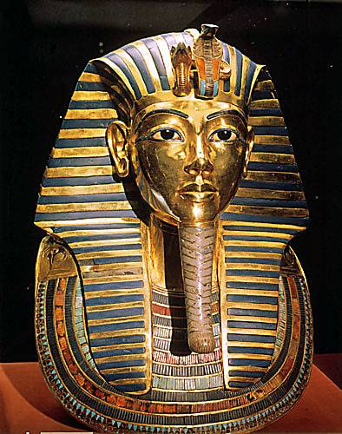
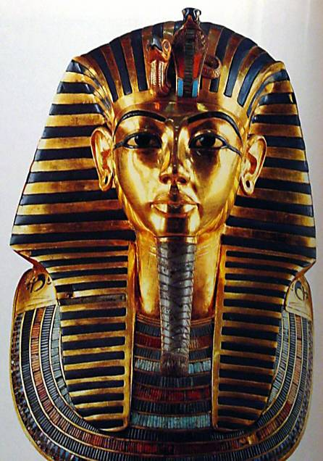
INNER COFFIN OF TUTANKHAMUN' SARCOPHAGUS

Slide 29
Aegean Cultures
Cycladic Minoan Mycenaean GREECE ROMAN

Slide 30
The Aegean
Between Greek peninsula and continent of
Asia minor (modern-day Turkey) arm of
Mediterranean known as Aegean Sea
Three artistic cultures
Cycladic - group of small islands in Aegean
Minoan - island of Crete
Mycenaean - mainland of Greece
Parallel in time to cultures of Egypt and
Mesopotamia beginning around 3,000 BCE.

Slide 31
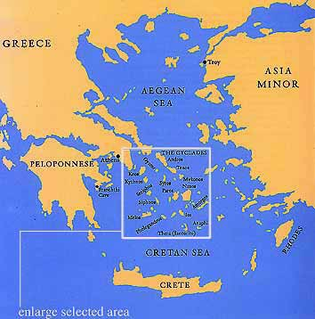

Slide 32
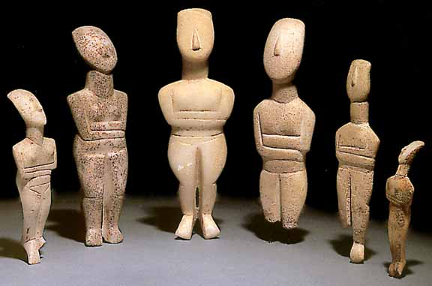
Cycladic Art -mostly nude female figures-simplified and abstract-

Slide 33
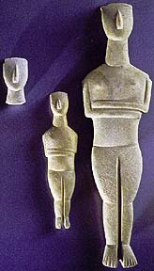

Slide 34
Minoan Culture on Crete
2000B.C.E.
City of Knossos
The name was taken from the legendary king Minos, who supposedly ruled at Knossos and his queen, gave birth to the half-human, half-bull, known as the Minotaur.
Frescoes, pottery, jewelry

Slide 35
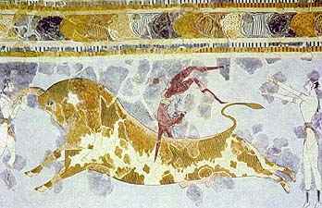
Minoan Frescoes “Toreador Fresco”

Slide 36
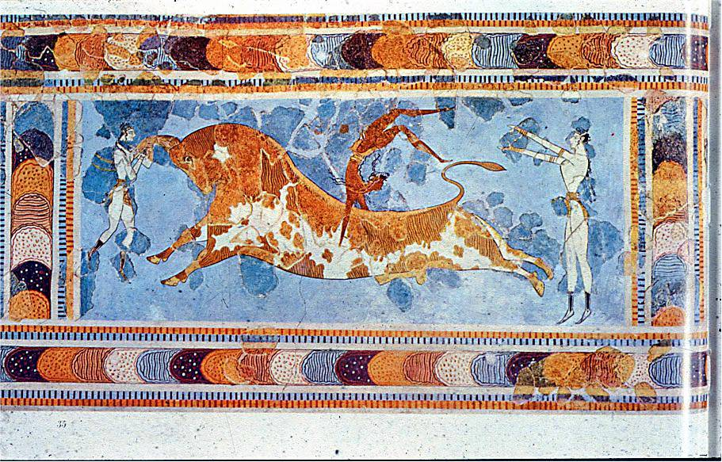

Slide 37
Mycenaean culture
formed the city of Mycenae
from 1600 to 1100 B.C.E.
noted for their burial customs and tombs
(an influence from the Egyptians)
The Mycenaean’s were master goldsmiths
They used gold to fashion masks, jewelry and weapons.

Slide 38
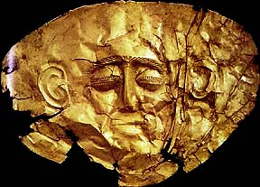
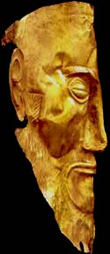
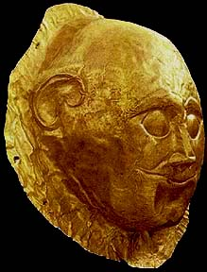
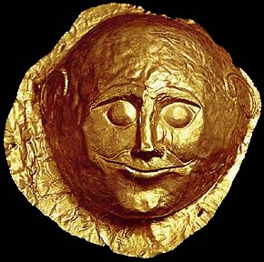

Slide 39
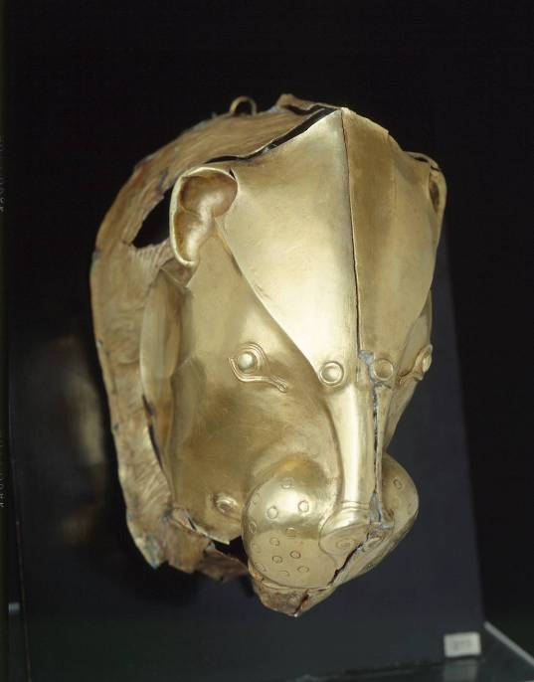
Rhyton in the shape of a lion's head, from Mycenae, c. 1550 B.C.E. Gold, height 8"

Slide 40
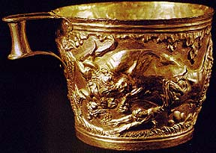
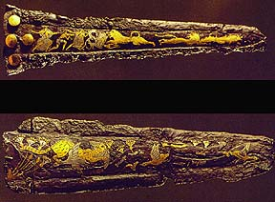
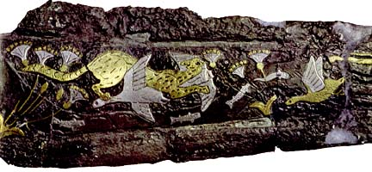

Slide 41
GREECE
Greeks excelled in many fields
Political ideals serve as a model of democracy
Poetry, drama, and philosophy live on as classics
The first to speculate on the nature and purpose of art
Sculpture, painting, and architecture were as techne, “things requiring a special body of knowledge and skill to make.”( technology & technique)

Slide 42
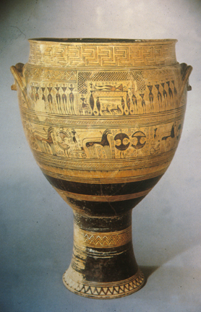
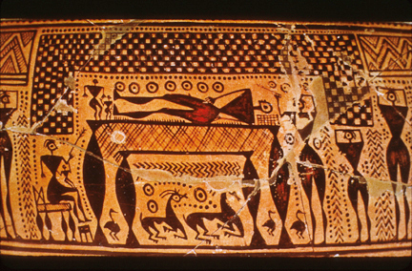
GREECE krater is a vessel used for wine. “Dipylon Vase” , 8th century, geometric style of vase painting

Slide 43
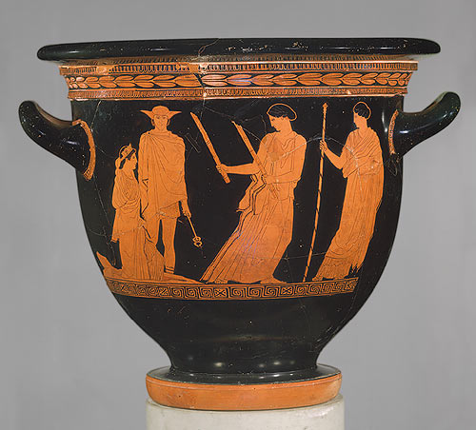
the red-figure style, 6th century B.C.E Eos and Memnon, (kylix).

Slide 44
black on red-figure

Slide 45
Classical Period “Warrior A,” Riace, Italy. C. 450 B.C.E. Bronze, with bone and glass eyes, silver teeth, and copper lipes and nipples, height 6’8”

Slide 47
The Classical period – the 5th and 4th centuries B.C.E Greece consisted of several independent city-states. Athens was built on a high hill, or acropolis. Perikles head of state & Sculptor Phidias

Slide 48
The highlight of the Acropolis The Parthenon Dedicated to the goddess Athena parthenos, or Athena the warrior maiden

Slide 49
Entasis-the slight swelling or bulge built into the center of a column to make the column seem straight visually.

Slide 53
Many sculptures are of young men, to whom scholars gave the kouros, meaning “youth” or “boy.” archaic period

Slide 54
the Classical style Kroisos

Slide 56
Greek art is known as Hellenistic—“a term that refers to the spread of the Greek culture eastward through Asia Minor, Egypt, and Mesopotamia—lands that had been conquered by the Macedonian Greek ruler Alexander the Great. Dramatic emotion and turbulence

Slide 57
Age of the Conquerors: Roman Art

Slide 58
Beginning 510 B.C.E. Became an Empire 27 B.C.E. when Augustus took the title of “Caesar.” At its height in A.D. 117

Slide 59
The Romans admired the works of the Greeks. They took their works back to Rome as well as Commissioned works

Slide 60
Roman art was more realistic in its portrayal of individuals. Double portrait of Graidias M. L. Chrite and M. Graditidas Libanus. Late 1st century B. C. E.

Slide 61
Equestrian Portrait- the portrayal of an admired leader on horseback

Slide 62
Paintings by the Romans at Villa of Mysteries, Pompeii 50 B.C.E. Fresco

Slide 65
Roman Colosseum
The Colosseum is roughly elliptical in shape
The overall height of the building is 48,5 metres (159’)
The arena measures 76 m by 44
The building stands on a base of 2 steps; there are 3 floors of arcades and a 4th storey with windows (see image on the right).
There were 80 arches on every floor, divided by pillars with a half column.
The ground floor half columns are doric in style, those of the second floor are ionic and those of the upper floor Corinthian. The attic is divided into panels by Corinthian columns, with a rectangular window every second panel.
The arches are 4.20 m. (13’9") wide and 7.05 m (23’1") high on the ground floor; on the upper floors they are only 6.45 m (21’2") high
The seating was raised 3.60 m above the arena, and it has a gradient of 37°
The ancient capacity is calculated between 50.000 and 75.000 spectators
300 tons of metal were used for the iron clamps that connected the limestone blocks together
The ground floor, in limestone, is 90 cm thick on average
Over 100.000 cubic metres of travertine stone were used (45.000 for the external wall only)
A road about 20 km long was built to transport the travertine stones from the quarries near Tivoli
All around the top there were sockets for 240 wooden beams which supported the awning.

Slide 68
Artemidores, from Fayum. 100-200 C.E.

