Slide 1
Living with Art

Slide 2
Key Terms
Aesthetics: branch of philosophy that deals with the nature, beauty and meaning of art, and our response to it.
Megaliths: a large massive stone.
Vanitas: (vanity) fleeting nature of earthly life and happiness.

Slide 3
Abstraction
It allows for universal ideas.
It gives the essence or pure form of a concept like birth, kiss, flight, dream.
This is what Brancusi was thriving for in his works.

Slide 4
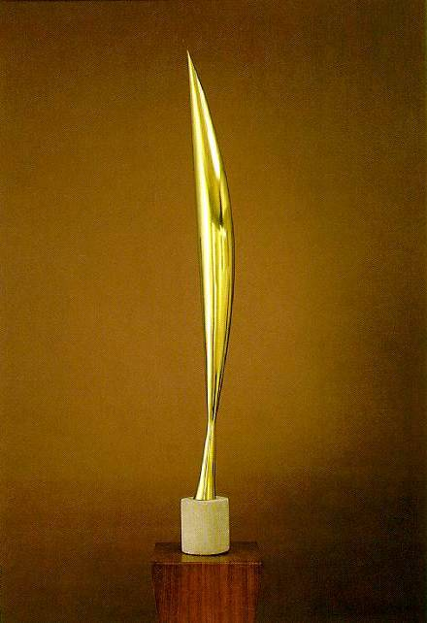
“Bird in Space”, Constantin Brancusi 1928-30
Brancusi was searching for forms that were simple, pure, and timeless.

Slide 5
Aesthetic Experience
Aesthetics: branch of philosophy that deals with the nature, beauty and meaning of art, and our response to it.
Experiences we have through sight, hearing, taste, touch, and smell.
Aesthetics concerns itself with our responses to the natural world and to the world we make, especially the world of art.

Slide 6
The Impulse for Art
Jean-Marie Chauvet discovered a cave in southeastern France on December 18, 1994.
Images in Chauvet Cave were dated back to Paleolithic 30,000 B.C.E. by radiocarbon testing.
Interest in order and structure, aesthetics,
Constructing images that have meaning

Slide 7
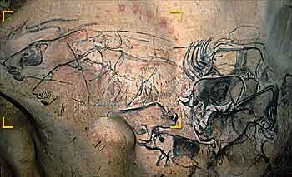
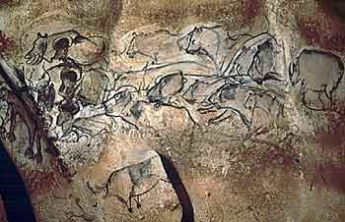
Chauvet cave images
These are the kind of instruments used to produce these works of art: flint burins to engrave the drawings, bone-marrow lamps for lighting, charcoal pencils to outline in black and grey, ochre pigments to produce the bright reds, and pads (animal fur) to daub the paint on the rock, animal fats and pigments mixed together, reed brushes, powdered pigments blown through hollow reeds.

Slide 8
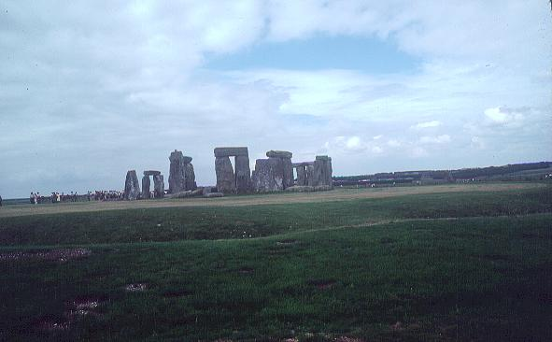
Stonehenge
British sculptor Anthony Caro “ all art is basically Paleolithic or Neolithic: either the urge to smear soot and grease on cave walls or pile stone on stone.”

Slide 9
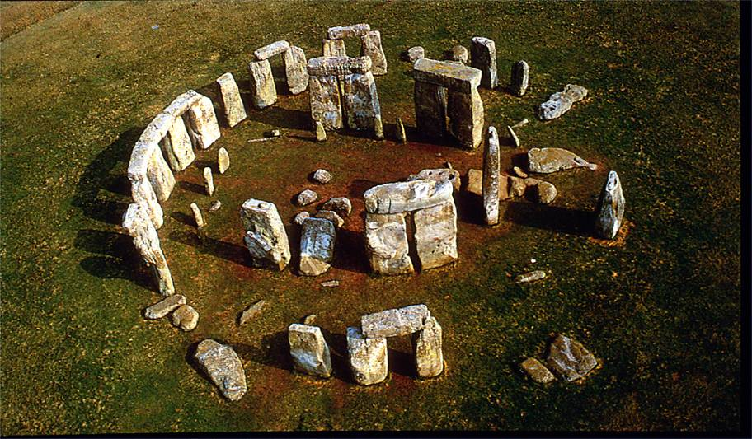
Stonehenge consisted of several concentric circles of megaliths, very large stones, surrounded by a circular ditch. It was built in phases over centuries beginning around 3100 B.C.E

Slide 10
The Neolithic era is named for the new kinds of stone tools that were invented as well as advances in domestication of animals and crops. Its also the development of the technology of pottery, as people discovered that fire could harden certain kinds of clay.

Slide 11
Reasons for Making Art
• We have the ability to make images.
We have an urge to create meaningful order and form
to structure our world so that it reflects our ideas.
We have the urge to explore aesthetic possibilities of new technologies.

Slide 12
What do artists do?
Artists fulfill practical roles, designing every structure or object that is built or made.
Artists who work with images—painters, sculptors, and photographers—also perform practical roles.
The need for Art:
To create places for human participation
To create extra-ordinary versions of ordinary objects
To record and commemorate
give tangible form to the unknown
give tangible form to feelings and ideas
Refresh our vision and see the world in a new way

Slide 13
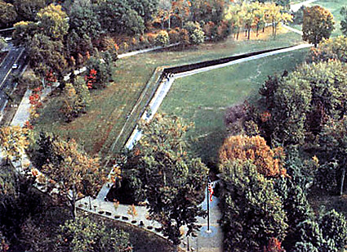
create places for some human purpose “Vietnam Memorial “ Maya Ying Lin
1982

Slide 14
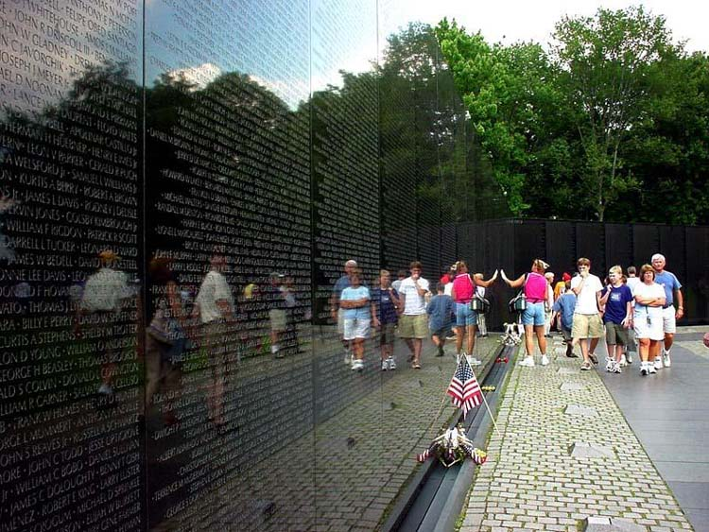

Slide 15
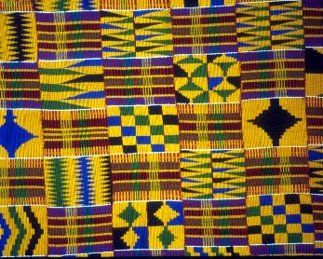
To create extra-ordinary versions of ordinary objects Kente Cloth, Ghana
Kente is woven in patterns , each with its own name, history, and symbolism

Slide 16
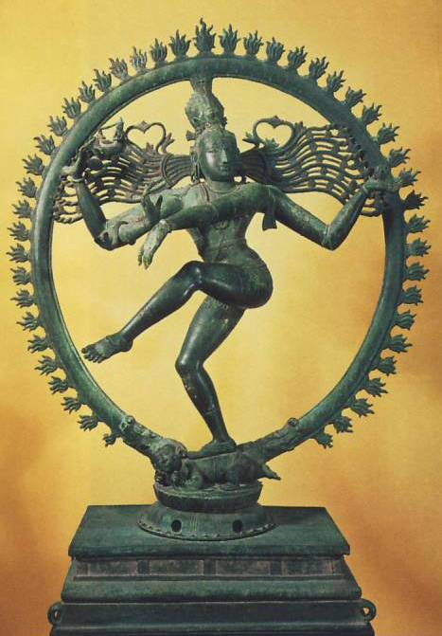
give tangible form to the unknown - Indian sculptor of the 11th century Hindu god Shiva in his guise as Nataraja, Lord of Dance. Bronze, height 43 7/8”

Slide 17
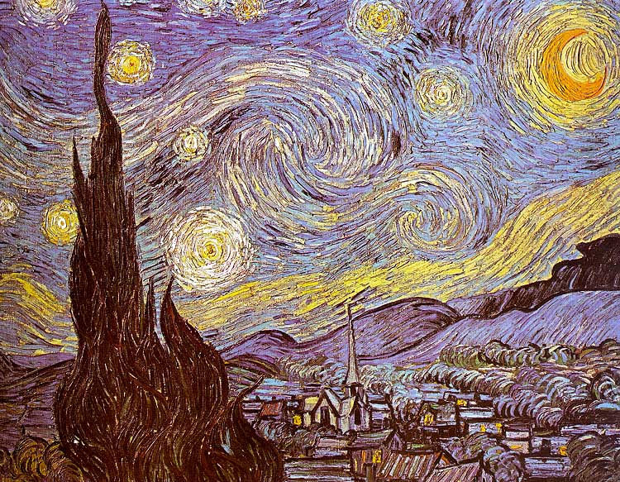
Artists give tangible form to feelings and ideas Vincent Van Gogh created a visual equivalent for his feelings in Starry Night, 1889. Oil on canvas

Slide 18
Traits of Creative People
Sensitivity
Flexibility
Original
Playfulness
Productivity
Fluency
Analytical
Organizational Skill

Slide 19
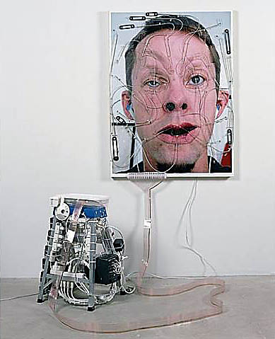
Creative work- Tim Hawkinson, Emoter, Altered Ink-Jet Print, Monitor, Stepladder & Mechanical Components, h: 49 x w: 17 x d: 16 in / h: 124.5 x w: 43.2 x d: 40.6 cm

Slide 20
Looking and Responding at Art
Perception suggests that the most important key to looking at art is to become aware of the process of looking itself.
Selective perception-focusing on the visual information we need for the task at hand and relegating everything else to the background.
Process of seeing
Art requires us to revise our habits of looking, to take the time record every detail.

Slide 21
Juan de Valdes Leal. Vanitas. 1660. Oil on canvas, 51 3/8” x 39 1/16”

Slide 22
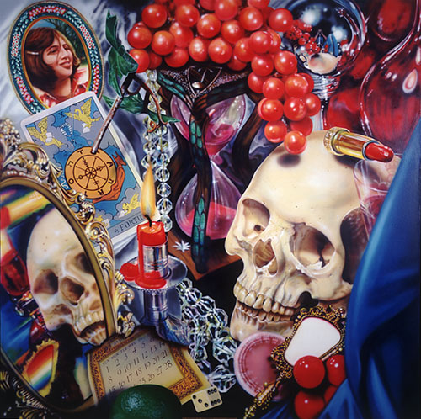
Audrey Flack. Wheel of Fortune (Vanitas). 1977-78. ) Oil over acrylic on canvas, 8’ x 8’

Slide 23
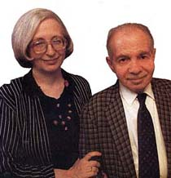
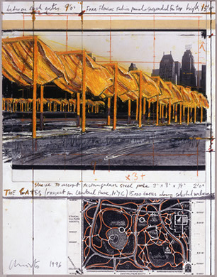
Dorothy and Herbert Vogel
Art Collectors who are ordinary people,a librarian and a postal worker.They Collected Over 2,000 Works of Art by artists including Chuck Close, Carl Andre, Andy Warhol, Richard Tuttle, Lynda Benglis, Sol LeWitt, Robert Smithson, Agnes Martin, Donald Judd, and Christo

